Slide 1


Student Collaboration Hub
Empowering Collaboration and Learning. Welcome to the presentation of the Student Collaboration Hub, a project that aims to provide a platform for students to collaborate, share, learn, and grow.

Slide 2

Introduction
In today's world, collaboration is essential for success. The Student Collaboration Hub is a platform that allows students to come together and work towards achieving their academic goals, both individually and as a team.

Slide 3
Algorithms:
Link : here

Slide 4

Problem Statement
Despite the numerous advantages of collaboration, students face various challenges while trying to work together. These include communication issues, lack of coordination, lack of accessibility, and more. Additionally, there is no single centralized platform available to students that can adequately address these issues.

Slide 5

Solution Overview
The Student Collaboration Hub is a comprehensive solution, providing a diverse range of features that cater to the needs of students. The platform is designed to help students improve communication, coordination, and accessibility while fostering a collaborative environment.

Slide 6
Feature Highlights
Alumni Information
Collaborative Document Editing
Connect with alumni for mentorship and guidance. Get first-hand advice and insights about career opportunities and professional growth.
Work in real-time with your teammates on documents, presentations, and code. Increase productivity, track changes, and effectively complete group projects.
Discussion Forums
Project Management Tools
Engage in discussions, ask questions, and share insights. Promote critical thinking, knowledge sharing, and collaborative learning.
Organize and track progress on group projects. Keep everyone on the same page and meet deadlines with ease.

Slide 7
Feature Highlights
Peer Review System
Resource Sharing
Receive and provide constructive feedback on assignments. Improve your skills, learn from your peers, and become a more well-rounded student.
Share study guides, lecture notes, and additional learning materials. Access a wealth of resources created by users with diverse backgrounds and experiences.
Event Calendar
Skill Exchange Marketplace
Schedule study sessions, group meetings, and collaborative activities. Stay organized, motivated, and on top of your academic commitments.
Offer and request help for specific skills. Collaborate with other students to improve your skills and knowledge.

Slide 8
Feature Highlights
Virtual Study Rooms
Career and Internship Board
Collaborate through video calls, screen sharing, and whiteboarding. Work with your teammates as if you were in the same room, regardless of your location.
Access job postings, internship opportunities, and career advice. Broaden your career prospects, network with industry professionals, and develop your career skills.
Technical Blogs Page
Coding and Challenge Section
Share and explore technical blogs within the community. Stay up to date with the latest trends and insights, and showcase your skills and knowledge.
Promote hackathons, coding challenges, and programming competitions. Challenge yourself, learn new skills, and have fun while doing it.

Slide 9

Feature Highlights
Integration with Learning System
Enjoy seamless integration with existing learning management systems. Access all the tools and resources you need in one place.
Accessibility Features
Ensure inclusivity with features like text-to-speech and alt text. Provide equal opportunities for all students to access and benefit from the platform.

Slide 10
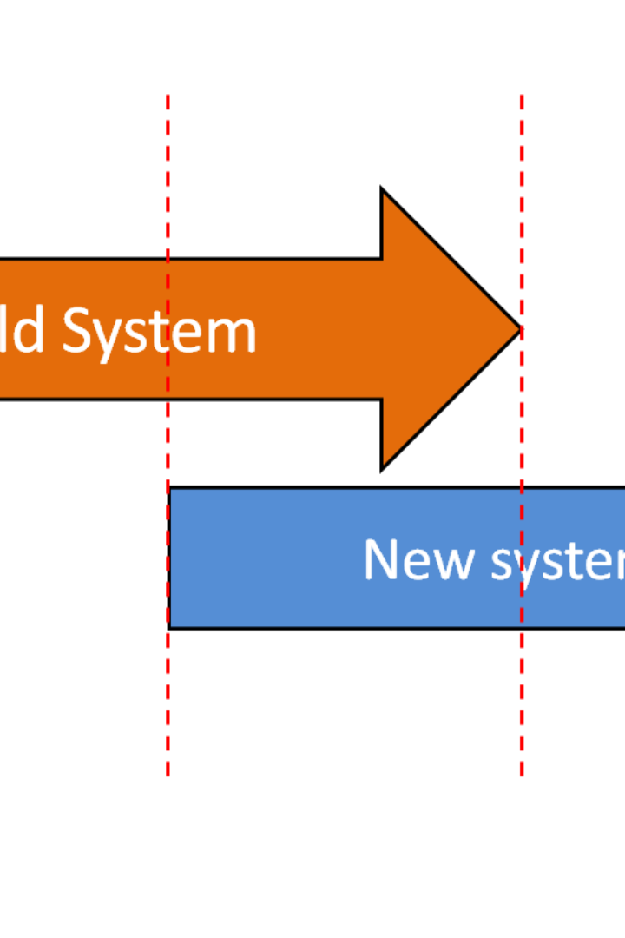
Technical Implementation
The Student Collaboration Hub uses a wide range of technologies, including ReactJS, Node.js, MongoDB, and Firebase Cloud Functions. The platform integrates with multiple APIs to provide seamless connectivity with various systems and applications. The team also used Agile development methodologies to ensure efficient and iterative development.

Slide 11

Future Enhancements
The Student Collaboration Hub has several features and enhancements planned for the future. These include expanding the career and internship board, adding gamification elements to incentivize collaboration and skill-building, integrating more accessibility features, and more. Additionally, the team is considering the potential of expanding the platform to cater to broader audiences beyond students.

Slide 12


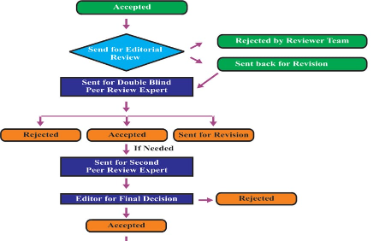
Demo/Prototype
Homepage
Virtual Study Room
Peer Review System
The homepage of the Student Collaboration Hub showcases the latest activity, featured resources, and news.
The virtual study room is a feature that allows users to collaborate through video calls, screen sharing, and whiteboarding.
The peer review system is designed to allow students to provide and receive feedback on assignments, further improving their skills and knowledge.

Slide 13

Challenges Faced
The development team faced several challenges while creating the Student Collaboration Hub. These challenges included managing a diverse range of technologies and APIs, ensuring seamless integration between different systems, handling remote collaboration efficiently, and more. The team implemented various solutions to these challenges, such as using containers for development, adopting best practices for API management, developing a robust testing strategy, and more.

Slide 14

Impact and Benefits
The Student Collaboration Hub is expected to have a significant positive impact on students' education and professional growth. The platform provides numerous benefits such as improved communication, coordination, accessibility, and more. Beyond that, the platform has the potential to enhance the educational experience of students, foster critical thinking, facilitate knowledge sharing, and encourage collaborative learning. Educational institutions can benefit from the platform as well, by leveraging the data and insights generated by the platform to better understand student needs, improve the quality of education, and provide better services to students.

Slide 15


Conclusion
The Student Collaboration Hub is an ambitious project that aims to make collaboration and learning easy, accessible, and fun. Through a comprehensive range of features, the platform provides students with tools and resources to improve their education, collaborate effectively, and grow personally and professionally. The team behind the project is proud of the work they have done and is excited about the prospect of bringing this platform to students worldwide.

Slide 16

AI Chatbot: Enhancing Collaboration and Support
Provides alumni information, expertise, and background
Picks key points from discussions
Shares study ideas related to your knowledge
Shares event dates and information
Provides articles and references
Posts in discussion forums
Provides tips with references
Schedules meetings for you
Helps with other problems related to this application
Our AI-powered chatbot is a valuable addition to the Student Collaboration Hub. It offers a range of features to enhance collaboration, support, and knowledge sharing. From providing alumni information and expertise to picking key points from discussions, sharing study ideas, event dates, articles, and references, posting in discussion forums, providing tips, scheduling meetings, and helping with application-related problems, our chatbot is here to assist you every step of the way.

Slide 17

Q&A
Thank you for your attention. We hope you found this presentation informative and engaging.

